Slide 1

Aurelia 2
The new 🔥
@mobilemancer

Slide 2



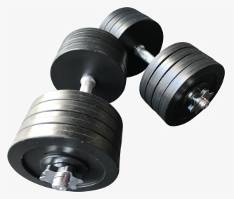

Andreas Wänqvist
@mobilemancer

Slide 3
The plan
Aurelia history
What makes Aurelia different?
What's new in Aurelia 2
Trying out Aurelia 2
Components
Dependency Injection
Router
Plugins
Productivity: The Aurelia VS Code Plugin
Lifting an Aurelia app to Aurelia2

Slide 4



Aurelia – A short history
v2
2011
2013
2016
2020
Notes:
Caliburn v1 2011-04-11
Durandal v1 2013-01-23
Aurelia v1 2016-06-27
Aurelia v2 2020

Slide 5
What Makes Aurelia Different
Convention over Configuration
Standards compliant
Performant Binding engine
Dependency injection

Slide 6
What's new in Aurelia 2

Slide 7
Documentation
Improved API docs!
Moving to Gitbook
We are very aware of the critique of the v1 docs
New and imroved content
https://docs.aurelia.io/

Slide 8
Performance
Memory Efficient Class-based Runtime
Update batching
DOM Update Granularity
Task Scheduler*
Time Slicing*
Multiple observation strategies*

Slide 9
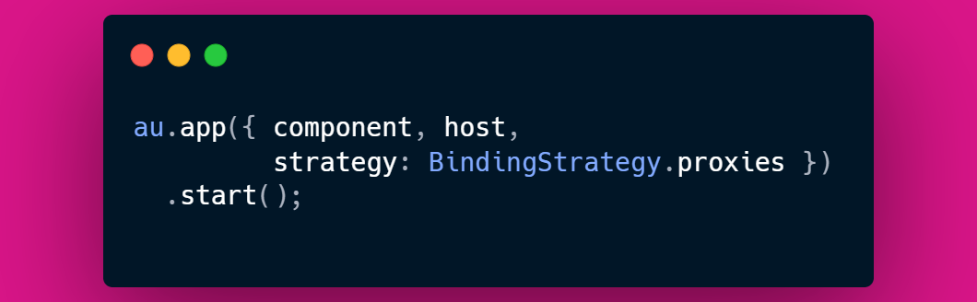
Performance – Observation Strategies
Use the strategy property to set binding strategy
Can be used on App startup and custom element decorators
Sets the observation strategy for a component and it's children
au.app({ component, host,
strategy: BindingStrategy.proxies })
.start();
Notes:
Good for the functional aspect, if you don't want the code to be mutated with getters/setters

Slide 10

Performance - Numbers
App startup is ~10x faster!
AOT tests show up to 100x!
Collection observation is ~5x faster
Sorting/reordering is ~30x faster!
Notes:
Reordering DOM nodes makes drag-and-drop, sorting, re-roder etc easier to implement and also faster

Slide 11
Web Standards
Shadow DOM
Decorators
Adopted Stylesheets*
CSS Shadow Parts*
CSS Modules*
Scheduler*
Notes:
Adopted Stylesheets (NEW) - This improvement to ShadowRoots enables sharing of CSS across Shadow DOM boundaries. Aurelia's CSS support makes using adopted stylesheets effortless, even if your browser doesn't yet support the standard.
CSS Shadow Parts (NEW) - A CSS feature that enables styling of the inner parts of Shadow DOM content from the outside, when elements are marked with a part attribute. Aurelia's new template part syntax enables decoupling template part replacement from CSS parts.
CSS Modules (NEW) - The upcoming standard for importing CSS through the ES Module system is already supported with Aurelia 2's new adopted stylesheets feature.
Scheduler (NEW) - A new task scheduling API has been in the works for standardization. The Aurelia team has been involved and we've implemented our new framework scheduler to take advantage of the new standard.

Slide 12
Extensibility
Resolvers & Registrations
Metadata
Startup Tasks*
Attribute Pattern*
Binding Command*
Instruction Renderer*
Notes:
Startup Tasks (NEW) - Improvements to app startup that enable any plugin to easily hook into application startup to ensure code is run at the appropriate time before creation or rendering of components.
Attribute Pattern (NEW) - A JIT extension point. Define custom patterns for interpreting attributes and turn them into the desired pair of value, target, and command.
Binding Command (NEW) - A JIT extension point. Associates the aforementioned command with built-in or custom rendering instructions. A rendering instruction instructs the renderer at runtime to produce, for example, a certain type of binding.
Instruction Renderer (NEW) - A runtime extensibility point that takes a specified rendering instruction and returns a built-in or custom binding, attribute, or component.

Slide 13
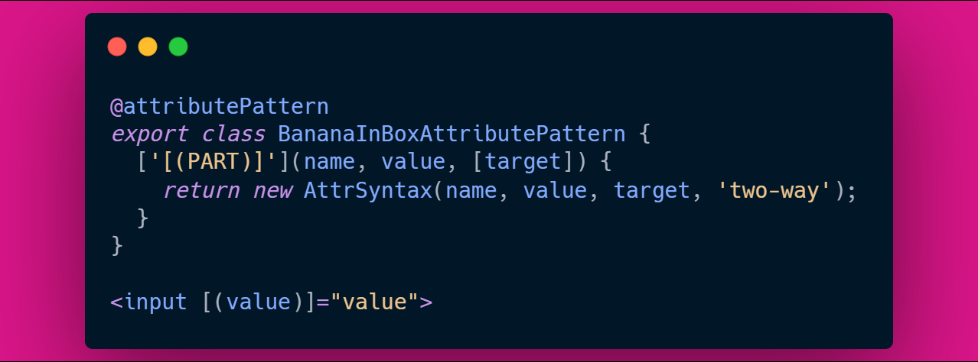
Extensibility – Angular Two-way Binding
Implement the following class and register it in the DI container:
@attributePattern
export class BananaInBoxAttributePattern {
['[(PART)]'](name, value, [target]) {
return new AttrSyntax(name, value, target, 'two-way');
}
}
Used in template:
<input [(value)]="value">

Slide 14
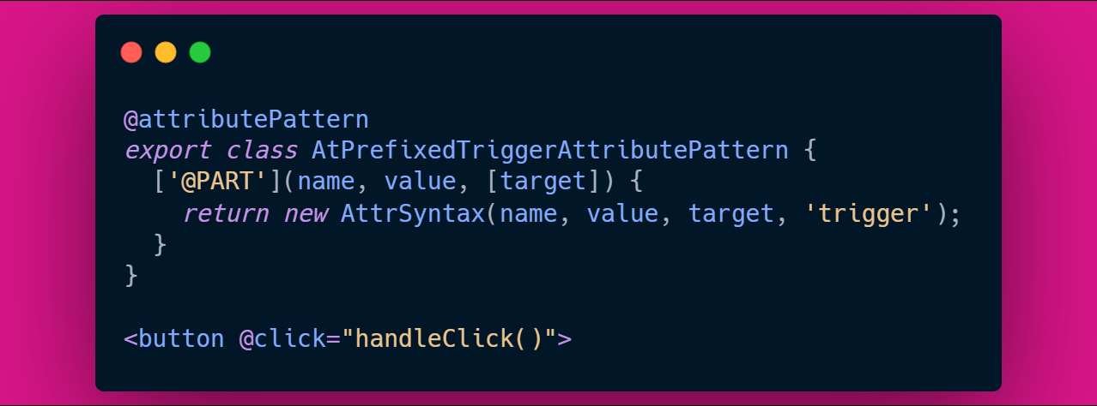
Extensibility – Vue Short-hand Syntax
@attributePattern
export class AtPrefixedTriggerAttributePattern {
['@PART'](name, value, [target]) {
return new AttrSyntax(name, value, target, 'trigger');
}
}
Used in template:
<button @click="handleClick()">

Slide 15

Extensibility – Vue Short-hand Syntax cont...
@attributePattern
export class ColonPrefixedBindAttributePattern {
[':PART'](name, value, [target]) {
return new AttrSyntax(name, value, target, 'bind');
}
}
Used in template:
<input :value="value">

Slide 16
Scaffolding
The easy way to create your first Aurelia2 project

Slide 17
Use the makes tool
npx makes aurelia
Bundler: Webpack or Dumber
Transpiler: Babel or TypeScript
Supports CSS Modules, Shadow DOM
Styling: CSS, Less, Sass
Unit Testing: Jasmine, Mocha + Chai, Tape
E2E Tests: Cypress

Slide 18
Components
The building block of all Aurelia apps

Slide 19

Components
Conventions – we've added styling!
Custom Elements
Functional Composition
Import to use elements / Global registration in DI container
Notes:
Name a code file, template file and styling file the same and Aurelia will compile them together

Slide 20
Binding Syntax
Nothing changes compared to v1, but everything is new
.bind
.two-way
.from-view
.to-view
.one-time
Notes:
The binding engine is rewritten from scratch.
Can now use proxys as well as getters/setters.

Slide 21
Component Examples

Slide 22
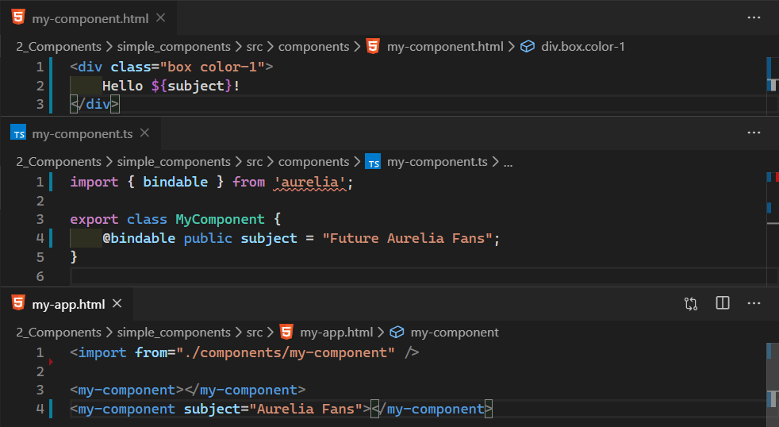
Notes:
An ordinary component, using the conventions of file naming

Slide 23
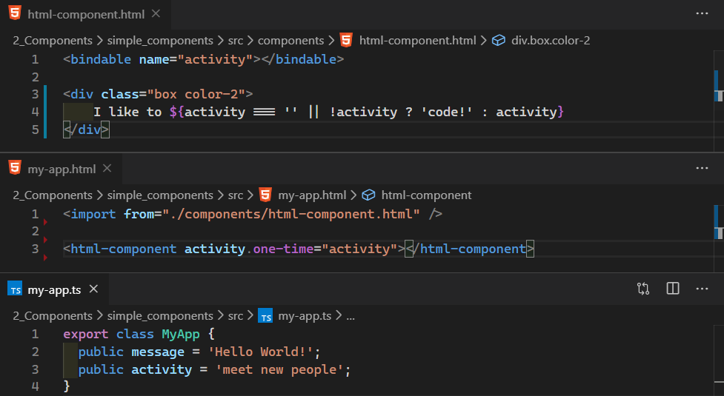
Notes:
A html-only component.
Note the <bindable> element!

Slide 24
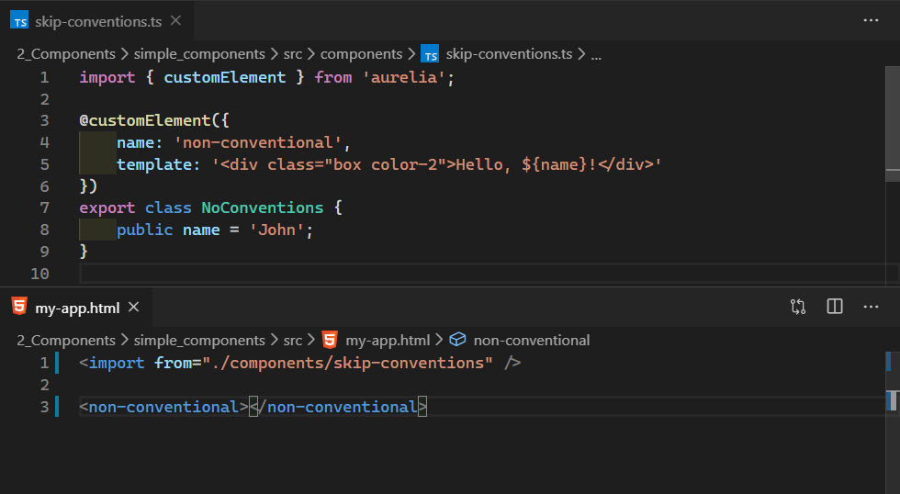
Notes:
A custom element.
Note how filename differs from the element name.

Slide 25
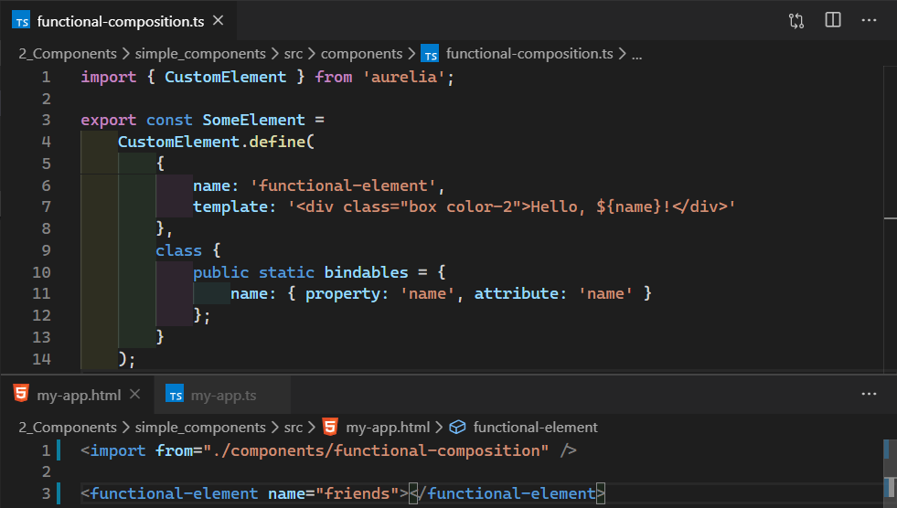
Notes:
Functional composition of an element.

Slide 26
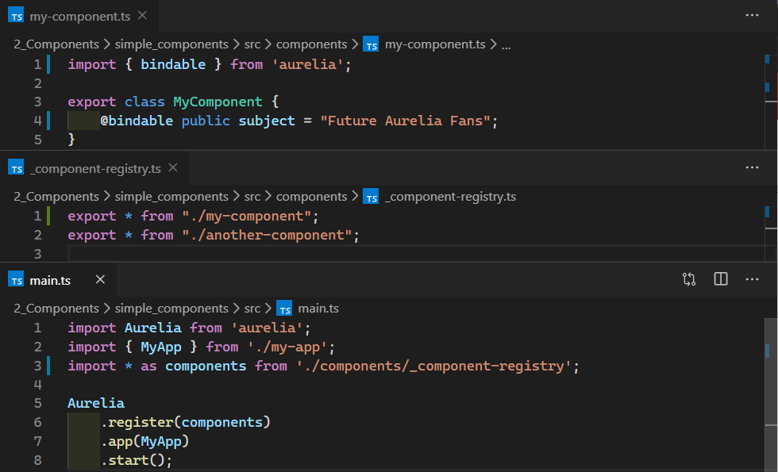
Notes:
Register components globaly by injecting them in the DI container

Slide 27
Lifecycle Events
Name Changes ahoy

Slide 28
Lifecycle Events
Aurelia 1
Aurelia 2
created
bind
attached
detached
unbind
beforeBind
afterBind
beforeAttach
afterAttach
beforeDetach
afterDetach
beforeUnbind
afterUnbind

Slide 29
Name Change
Old
New
binding
bound
attaching
attached
detaching
detached
unbinding
unbound
beforeBind
afterBind
beforeAttach
afterAttach
beforeDetach
afterDetach
beforeUnbind
afterUnbind
Notes:
https://docs.aurelia.io/getting-started/components
Changed to
https://github.com/aurelia/aurelia/pull/780

Slide 30
Dependency Injection

Slide 31
Registering Implementations
Singelton
Transient
Lazy
Callback

Slide 32
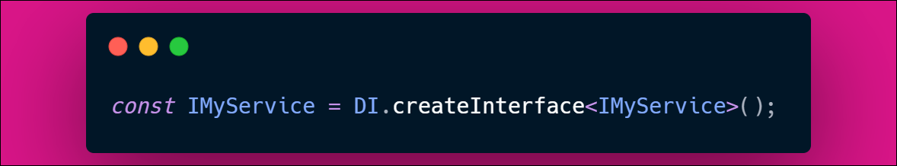
Using TypeScript?
Register a key and an implementation
Possible to inject an Interface 🤯
Helper available:
const IMyService = DI.createInterface<IMyService>();

Slide 33
Injecting Dependencies
Class decorator:
@inject(IMyDep)
Static inject array:
static inject = [IMyDep];
Parameter decorator:
constructor(@IMyDep myDep: IMyDep)

Slide 34
Dependency Injection Example
Inversion of control in action

Slide 35
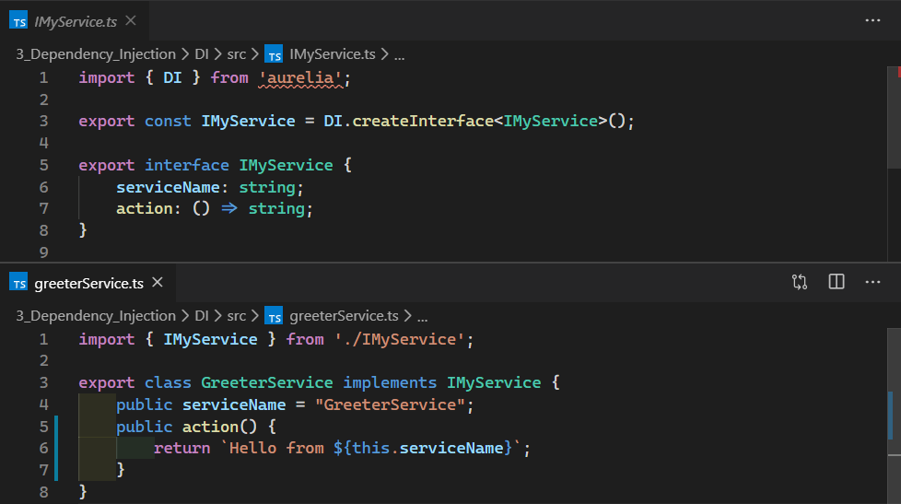

Slide 36
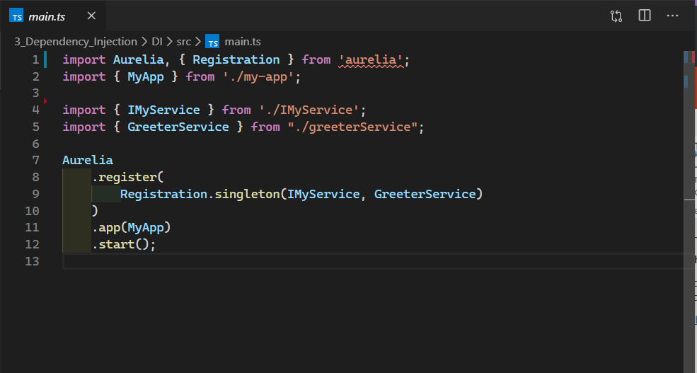

Slide 37
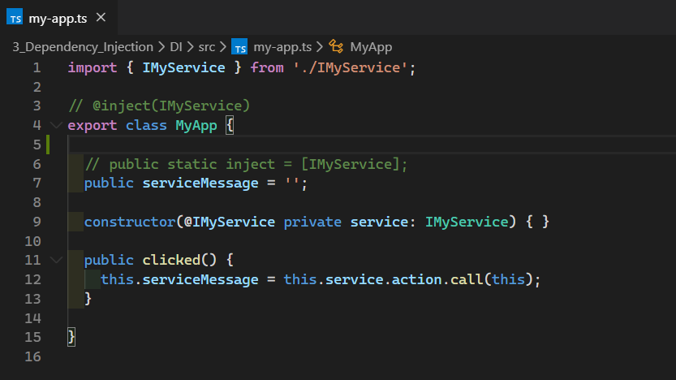

Slide 38
Router
It will blow your socks off!

Slide 39
Routing – Compared to v1
goto vs href
For those upgrading, or if you prefer using href
RouterConfiguration.customize({ useHref: true })
General thought is everything available in v1 should be available in v2

Slide 40
Router – (Probably) Lifecycle Changes
activate => enter
deactivate => leave
Order:
canEnter
enter
beforeBind*
canLeave
leave
beforeDetach*
Notes:
Main reason for renaming activate is that many mixedup activate with attached

Slide 41
Demo
Routing by convention!

Slide 42
Plugins

Slide 43
HTTP Client
Done
Identical to v1 (Fetch client)
Some improvements incomming

Slide 44
i18n
Done
Perf imrovements
Rewritten from the ground up
Benefits from au2 features like time sclicing etc

Slide 45
Validation
Almost done
Rewritten
Utilizes au2 structure better
Slightly changed API (cleaner)
Some additions that have been requested from v1

Slide 46
Store
Almost done
No breaking changes

Slide 47
SSR
Some work in progress on enhance
Au2 apps run as easily on node as in the browser

Slide 48
Testing
A lot of work is being done to enhance the testing experience!

Slide 49
Productivity
VS Code Extension

Slide 50
Aurelia VS Code Extension
From VS Code
Github: https://github.com/aurelia/vscode-extension
Configure filetypes according to your project
Syntax highlighting
Autocomplete
Open related file
Goto definition

Slide 51
Upgrading
REGEX!

Slide 52
Moving from v1 to v2
Most changes are search/replace
CompositionTransaction no longer needed – lifecycle events support async
PLATFORM.moduleName gone 🎉 Use regular imports
Unorthodox API usage? Will probably be an issue
Good documentation about what will need to be changed

Slide 53
Resources
Aurelia homepage: https://aurelia.io/
Aurelia 2 docs: https://docs.aurelia.io/
Discourse: https://discourse.aurelia.io/
Github: https://github.com/aurelia/aurelia
Aurelia Weekly: https://aureliaweekly.com/
We're moving from Gitter to Discord!
Discord: https://discord.gg/fh72aCn
Presentation & code: https://github.com/mobilemancer/aurelia2-demos

Slide 54
Thanks
The entire core team for being awesome!
Special thanks for helping out with this talk to:
@FredKleuver
@jwenzel_se
@EisenbergEffect
@shahabganji

Slide 55


Thank you!
@mobilemancer
linkedin.com/in/awanqvist

